Slide 1
2nd Project
Rene An
Makit
Jan 01, 2022

Slide 2
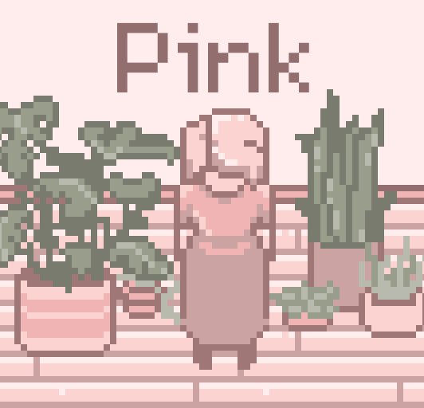
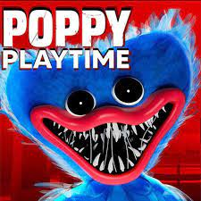
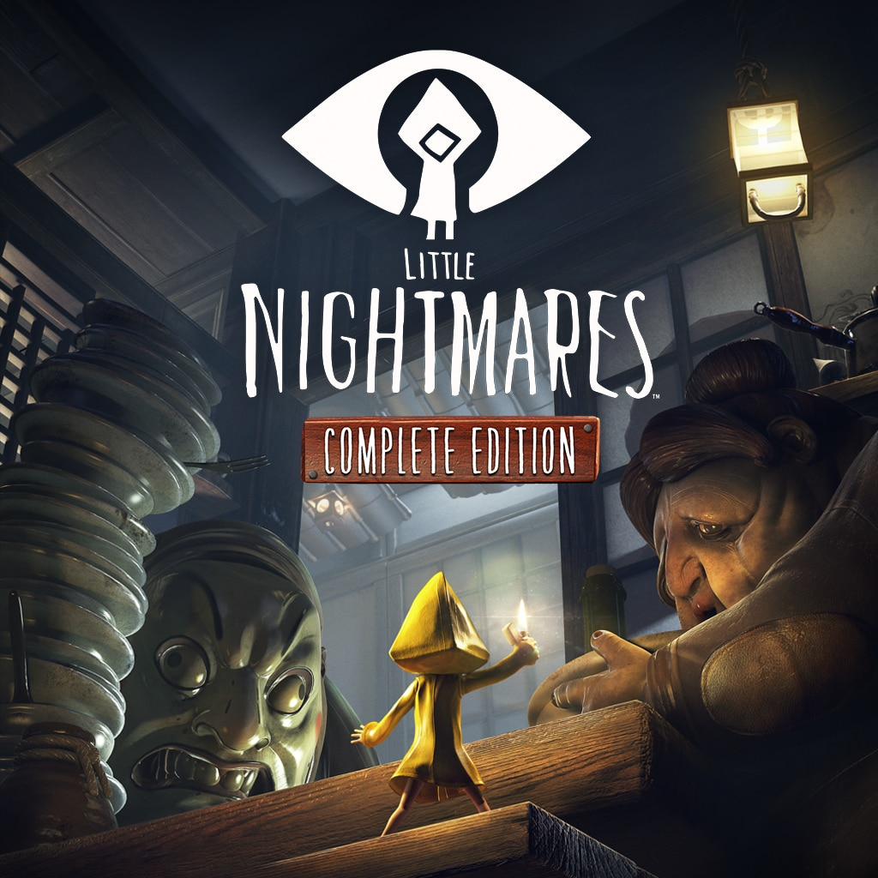

⭐Horror game style⭐
A room (Small map)
Many rooms (Big map)
Focus on view
- Add many puzzle games
- Or needs many texts
Need a good level design
Events
Need good art background
Need a good View quality

Slide 3

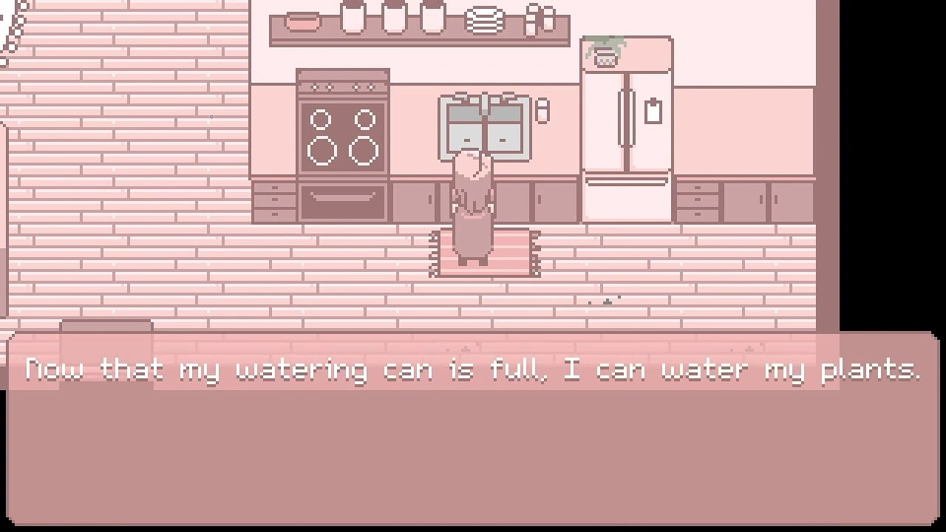
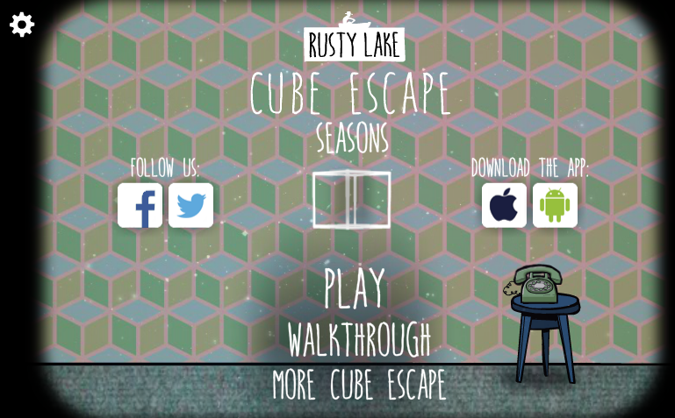
1. A room (Small map)
Pink (Text style)
Cube Escape in Rusty lake (Room escape)
What is Pink? (Download) : https://augogames.itch.io/pink
YouTube: https://www.youtube.com/watch?v=WkafgovjlrE&ab_channel=ManlyBadassHero
News: https://www.dreadxp.com/news/ultra-indie-daily-dose-everything-is-peaceful-and-normal-in-pink/
YouTube: https://www.youtube.com/watch?v=TLB-gOR-U1k&ab_channel=9FishGames%7COnlyExcitingGames

Slide 4
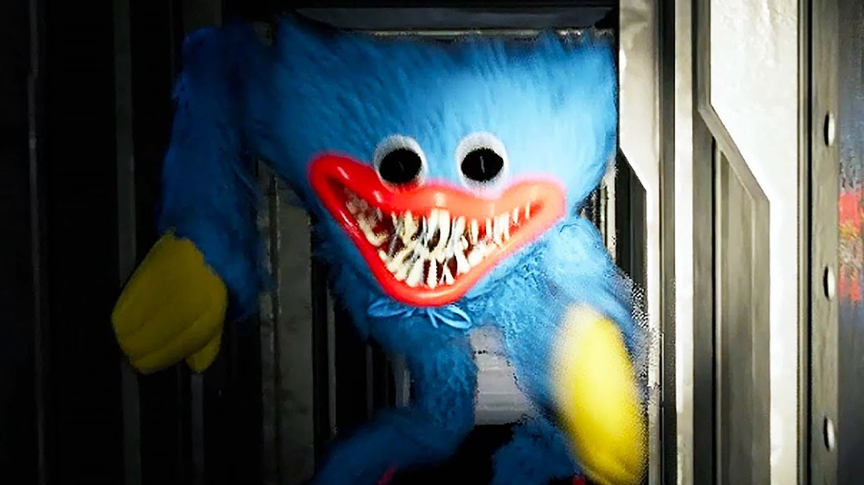
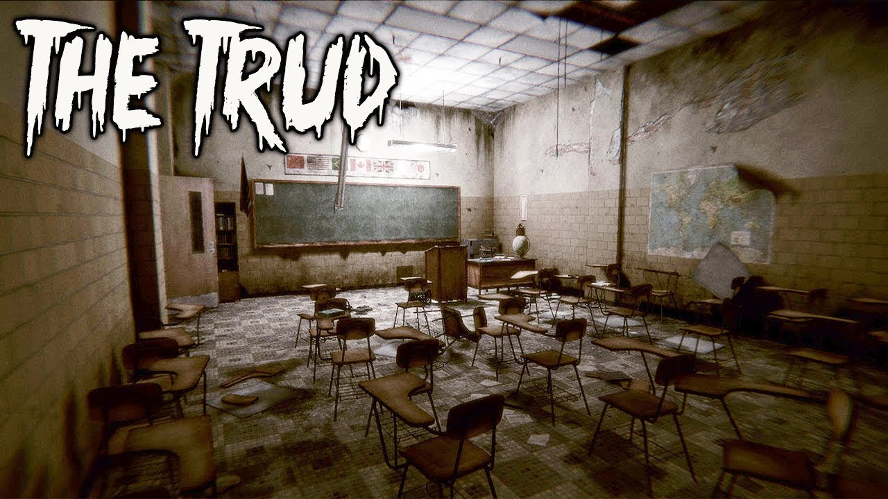
2. A big map
Poppy Playtime
The Trud | Demon Stalks Me At School
YouTube: https://www.youtube.com/watch?v=RKQGRPoDV_I&ab_channel=Markiplier
Good 3D models
A big map
YouTube: https://youtu.be/M5gH2Yswsos?t=919

Slide 5
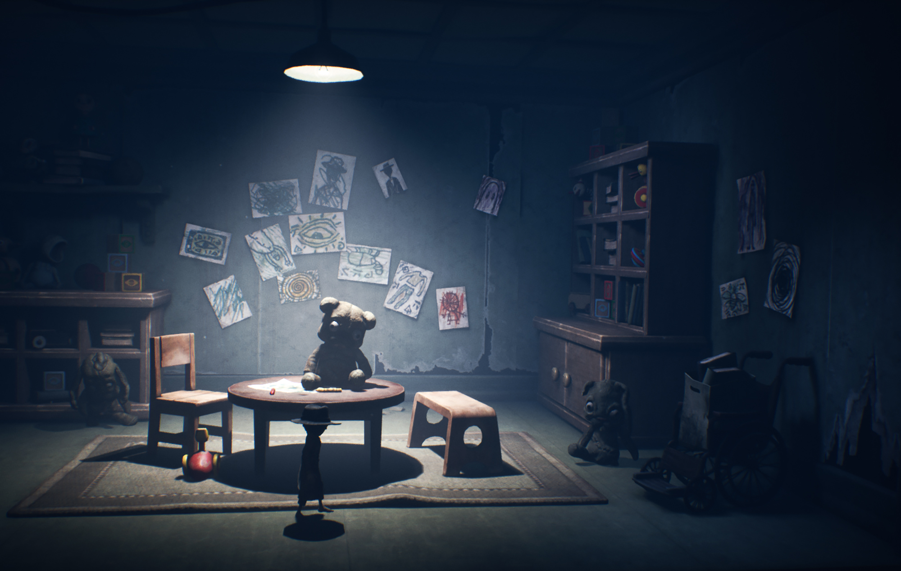
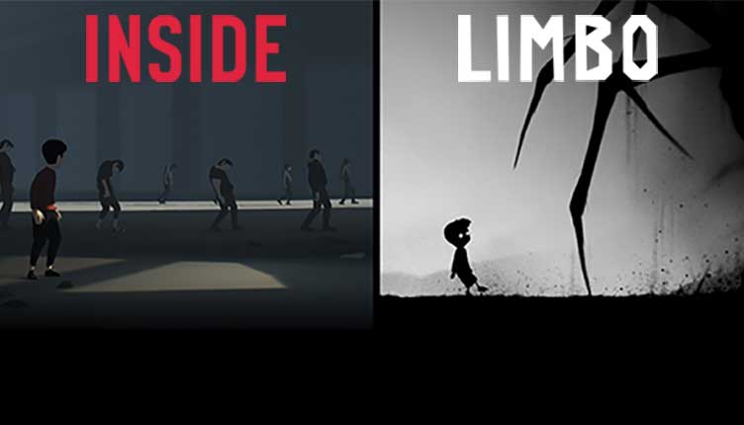
3. Focus on view
The little nightmares 1 & 2
Inside & Limbo
The games have a good view.
Those usually have a big map and a big volume.

Slide 6
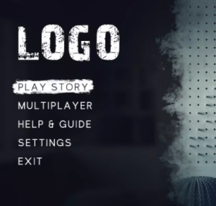
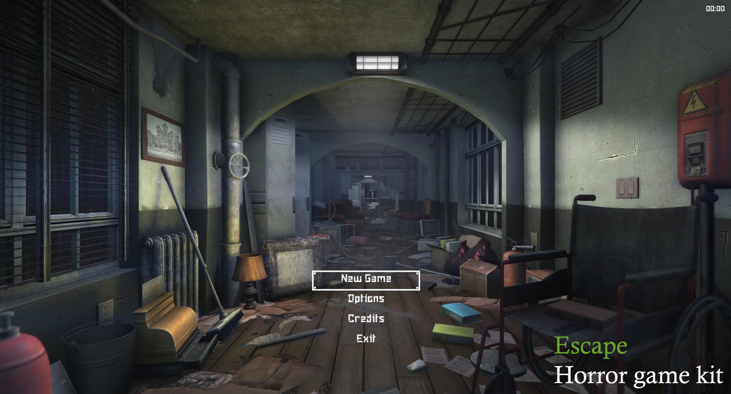
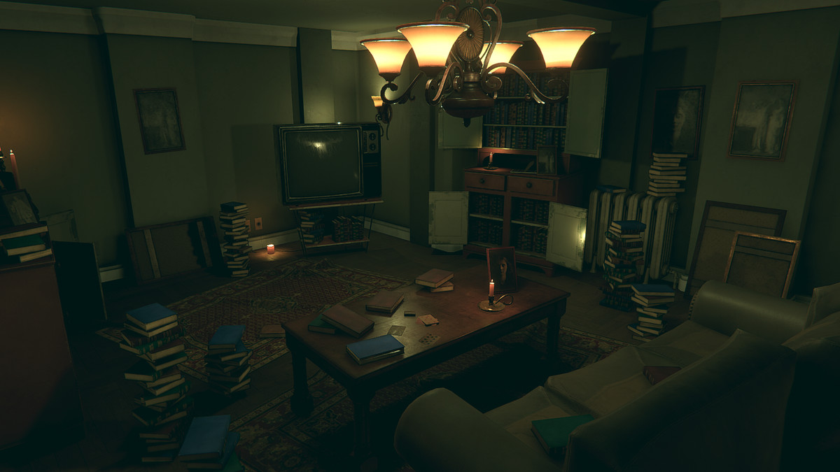
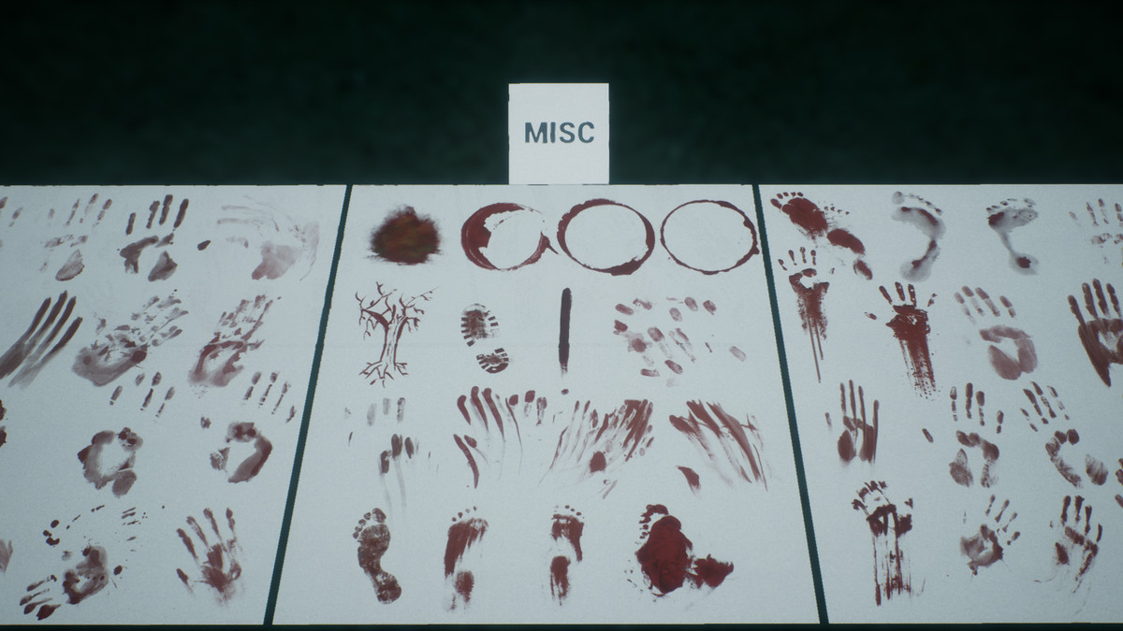
🎮Unity Asset Store 🎮
Dark - Complete Horror UI
Escape "Horror Game Kit"
Horror Rooms HDRP - Bundle
Horror Collection: Blood
$ 40
https://assetstore.unity.com/packages/2d/gui/dark-complete-horror-ui-200569
$ 68 → $ 34 (-50%)
https://assetstore.unity.com/packages/templates/escape-horror-game-kit-71885
$ 39.99 → $ 27.99 (-30%)
https://assetstore.unity.com/packages/3d/environments/urban/horror-rooms-hdrp-bundle-182068
$ 99.99 → $ 49.99 (-50%)
https://assetstore.unity.com/packages/2d/textures-materials/horror-collection-blood-123273

Slide 7
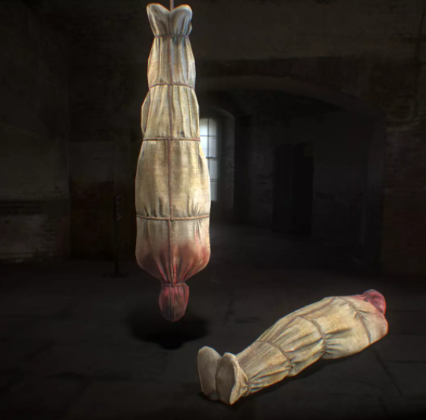

Story (Does not matter the user of view.) - 1 -3 main items (Pink: colour, water and plants.) - Short playtime - There are many texts. 😂
So… How about the profound story?
Rooms (Some maps)
- School (?)
No monsters

Slide 8
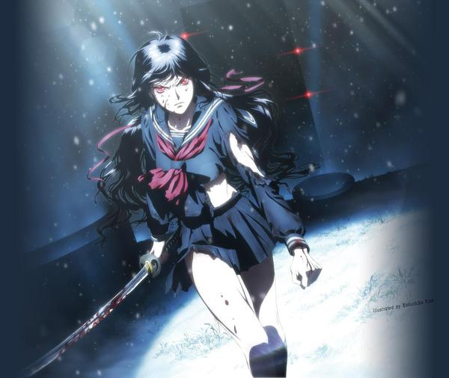
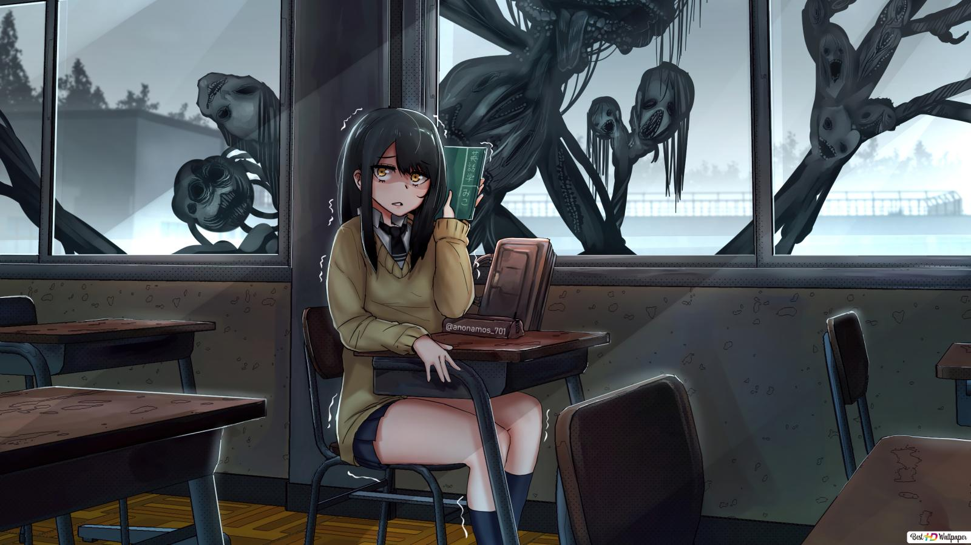
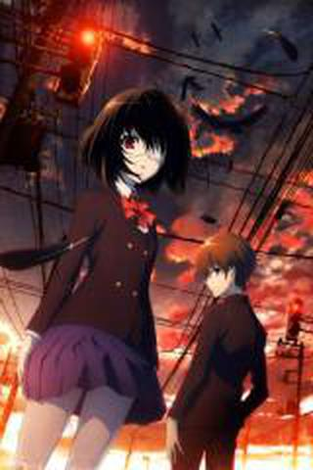
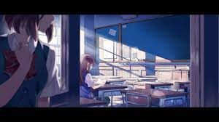
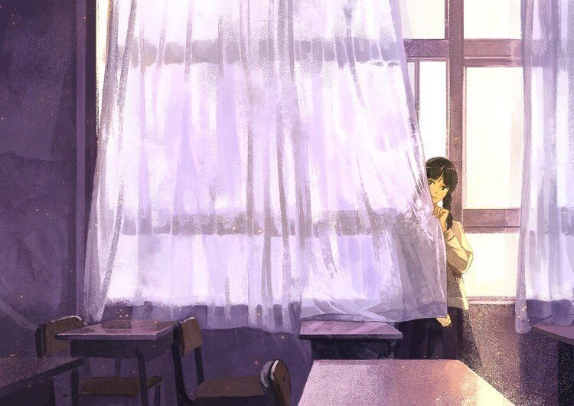
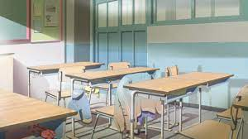
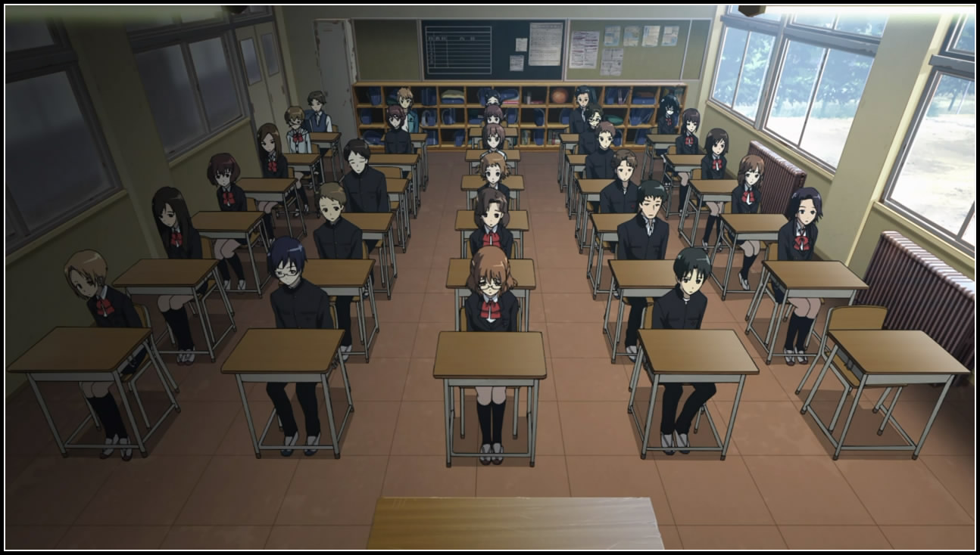
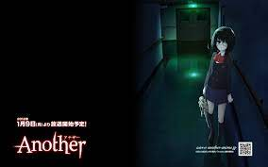
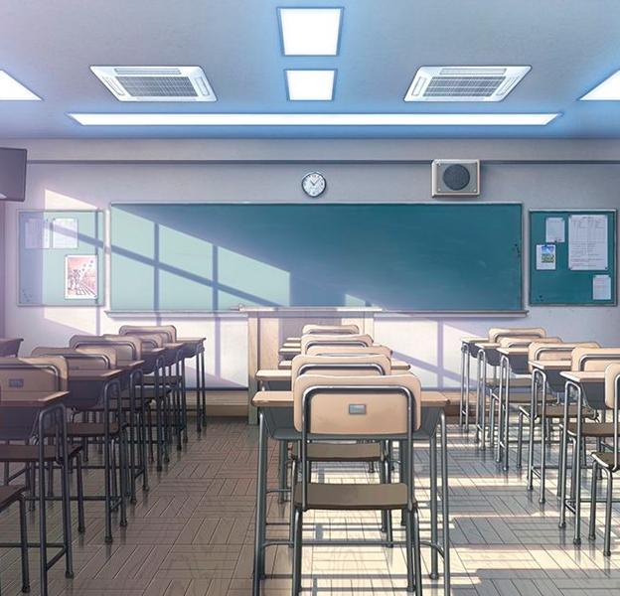
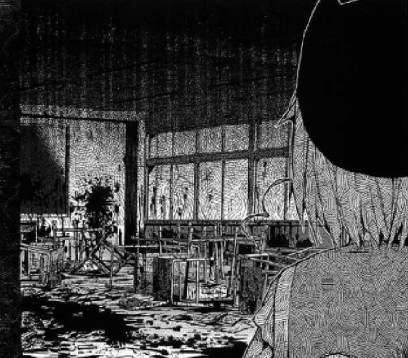
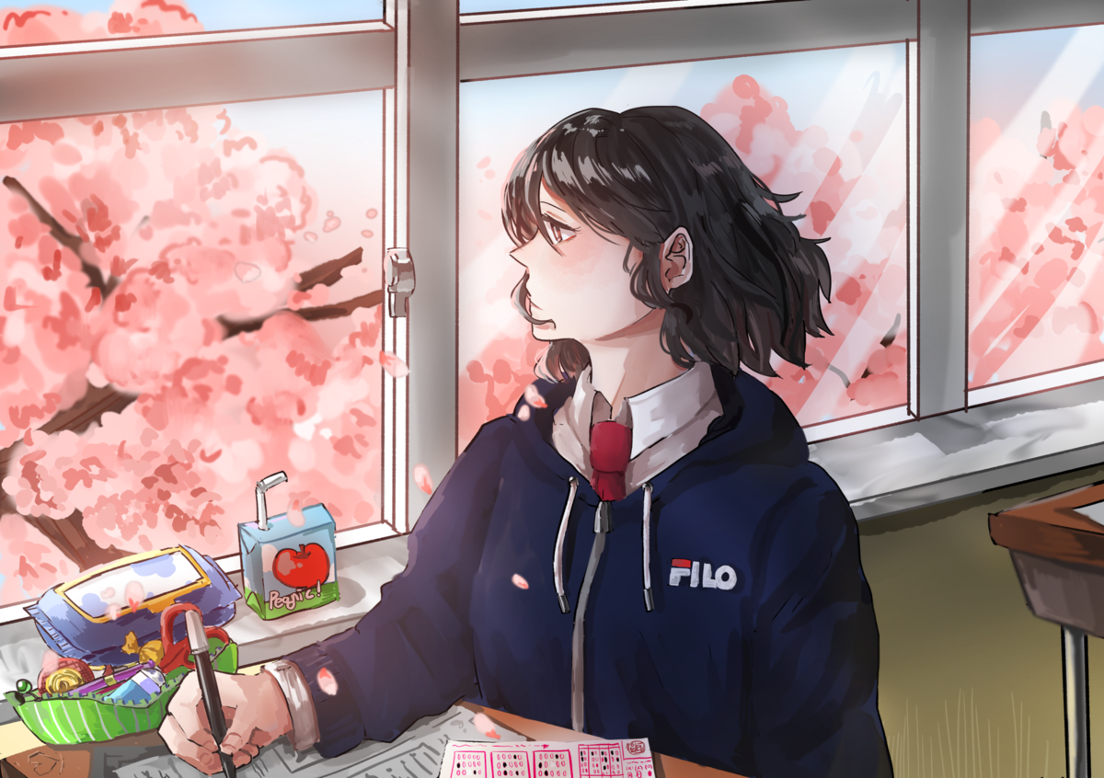
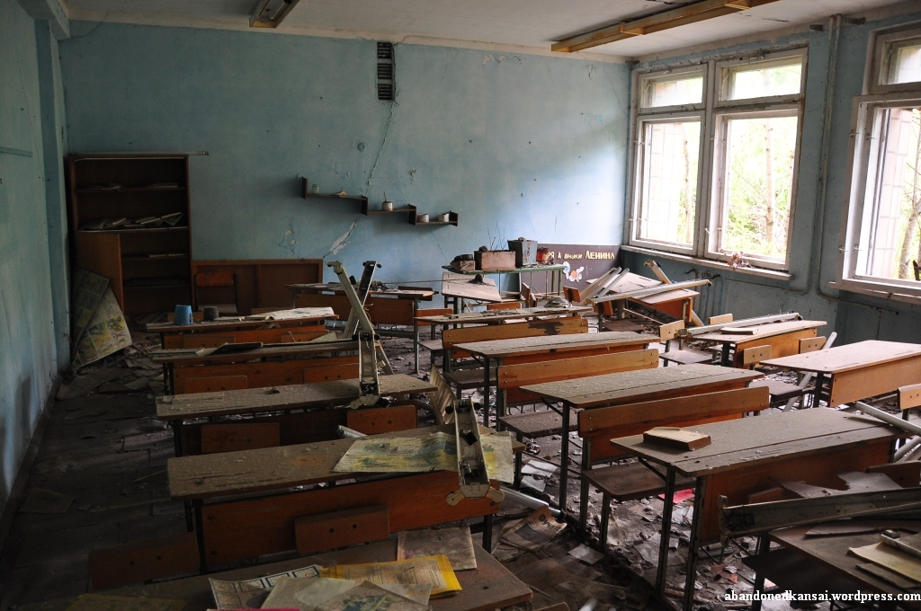
🏫 School
Example)
Soul Worker: https://www.youtube.com/watch?v=OLIJtqtoU4s&ab_channel=Steparu

Slide 9
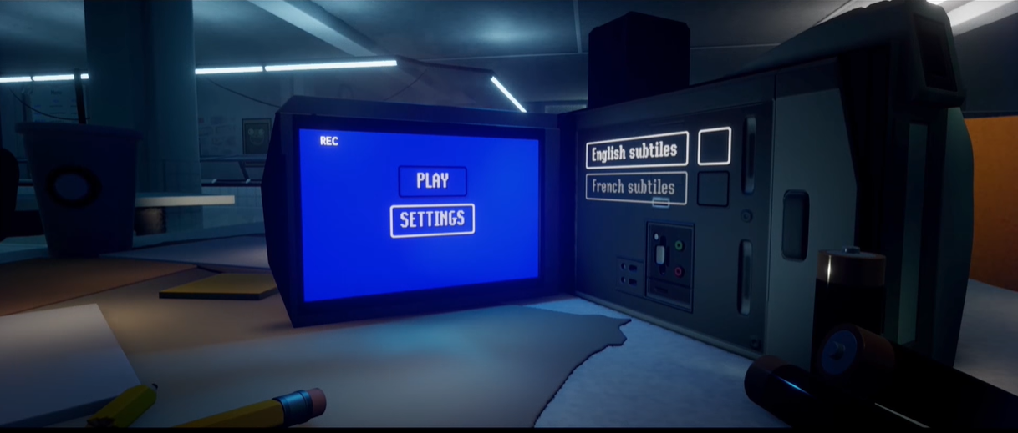
Intro
Dreams
I like the main screen. :)
YouTube: [00:27] https://youtu.be/Y-PnU2S4c_k?t=27

